Slide 1
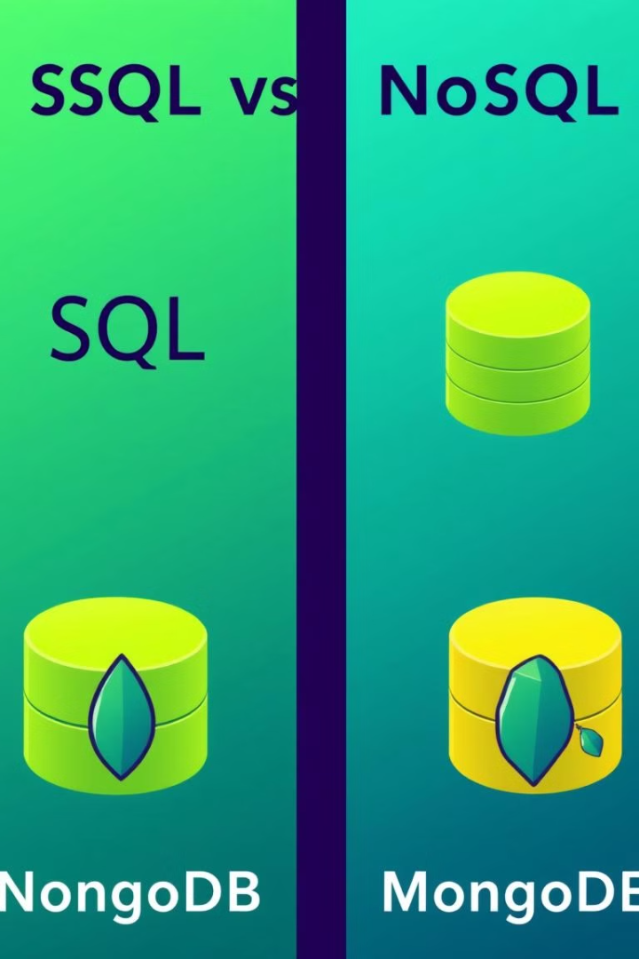

SQL vs. NoSQL Databases: MongoDB Focus
Exploring structured (SQL) and unstructured (NoSQL) database solutions. Concentrating on MongoDB as leading NoSQL database.
by K J

Slide 2
SQL Databases: Structured Data
Relational Model
Structured Query Language (SQL)
ACID Properties
Organized into tables with rows and columns
Ensures data integrity (Atomicity, Consistency, Isolation, Durability)
Standard language for data manipulation

Slide 3


MongoDB: Flexible NoSQL
Document-Oriented
Scalability
Flexible Schema
Designed for horizontal scaling and distributed systems
Data stored as JSON-like documents
Dynamic schemas; no need to predefine structure

Slide 4
SQL vs. MongoDB: Data Structure
SQL
MongoDB
Fixed schema
Dynamic schema
Tables with defined relationships
Documents within collections

Slide 5



SQL vs. MongoDB: Scalability
SQL
Vertical scaling (increase hardware)
MongoDB
Horizontal scaling (add more machines)

Slide 6

SQL vs. MongoDB: Use Cases
SQL
MongoDB
Financial transactions
Content management
Inventory management
Mobile apps
Both
Reporting
Analytics

Slide 7
SQL vs. NoSQL: Community and Support
SQL
MongoDB
Mature technology
Large and growing community
Extensive documentation
MongoDB Atlas cloud platform

Slide 8

Key Takeaways: SQL vs. MongoDB
1
SQL
2
MongoDB
Structured data, ACID compliance
Flexible, scalable, document-oriented
3
Consider project requirements
Choose database to match needs

